Slide 1
Database Design Chat 003
The Ugliest Design Mistake?

Slide 2
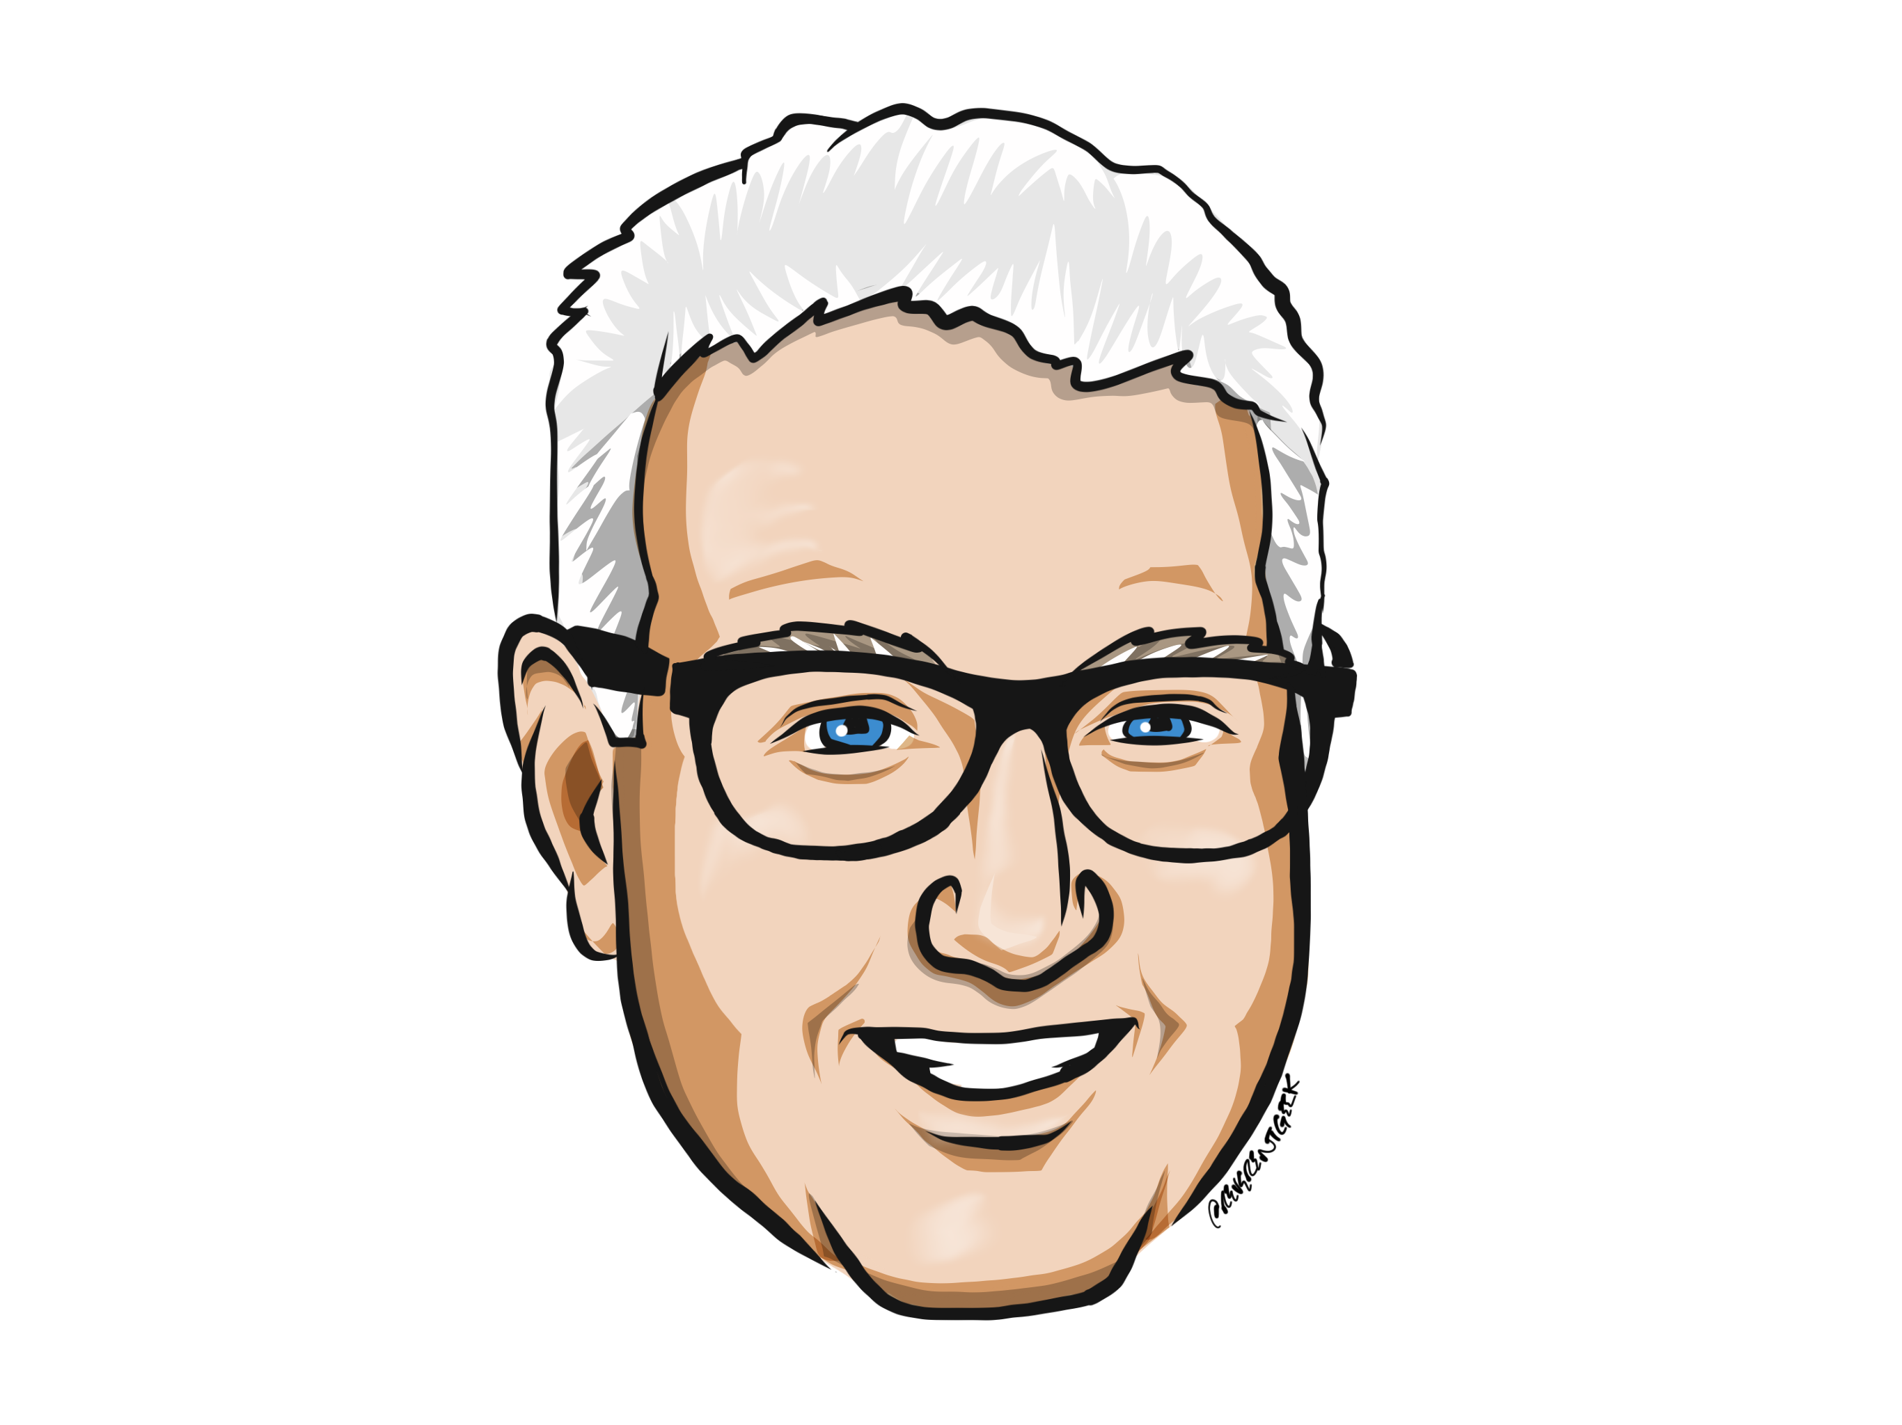
Louis Davidson (drsql)
https://linktr.ee/drsql

Slide 3
Naming
Proper names lead to proper usage of names
People work better with repeatable patterns
Naming standards help greatly
Example:
A table has two columns: FirstName nvarchar(100) and BecameCustomerOnDate nvarchar(100)
The FirstName column contains values like ‘2021-09-22’ and ‘Tuesday’ and BecameCustomerOnDate contains a string like ‘Louis’, ‘Lillian’ …
Ok, this was obviously an exaggeration..

Slide 4
More Real Example
A table has columns: StateCode int and StateId uniqueidentifier
Another table has a StateOrTerritoryId uniqueidentifier column
The database has a State table, and a StateOrProvince table
The user sits down to write a query… what now?

Slide 5
Until next time…
Remember that correctness is the only goal worth achieving.
Naming is one of the main parts of the coding process that leads to correctness
If a user thinks they are getting one number value, but really it means something different… hope your life isn’t in their hands
On a later episode, we will look at possible naming standards
Even a bad standard can be followed and eventually undersood

Slide 6
Questions?
If you have questions, you can:
Comment on YouTube
Email drsql@hotmail.com
Message me on Twitter at drsql
Contact me anywhere on https://linktr.ee/drsql
I may add an episode to discuss or reply directly

